Slide 1
Create in JavaScript your polyglot file
HTML / ZIP / PNG

Slide 2
Introduction
Web developer for 20+ years
Author of:
  zip.js: library for reading and writing zip files
  SingleFile: extension and command-line tool for saving a web page as a single HTML file
    use of Data URIs to reference and store binary content
    output file size larger than the size of all resources added together
Can SingleFile and zip.js be combined?
Is it possible to go further ?

Slide 3
Web project
1 - Creating a test project (HTML, CSS, JS) in /project
Inclusion of external resources:
  <link href=style.css>
  <img src=image.png>
  <script src=script.js></script>
  @import url(properties.css)
  url(background.png)
UTF-8 encoded content:
  <figcaption>Communauté des développeurs ...</figcaption>
  alert("Hello la communauté RennesJS ! 😚")
  content: "👋"

Slide 4
ZIP Format
Created in 1989 by Phil Katz at PKWARE (publisher of PKZIP)
Support of:
  DEFLATE compression since version 2.0 (1993)
  AES encryption since version 5.2 (2003)
  Version 2.0+ on most operating systems
Examples of formats based on the ZIP format:
  LibreOffice/MS Office documents .ODT, .DOCX, ...
  Java Archives .JAR
  Android Packages .APK and iOS Archives .IPA
  Web Extensions .CRX and .XPI

Slide 5
ZIP Format
File entries followed by the central directory
Suitable for streaming (read/write) but with some limitations
Some metadata are stored twice in local headers and the central directory: file name, last modification date, data size, etc.
The central directory is required and authoritative
The central directory contains the positions (relative offsets) of each entry in the ZIP file
The data in local headers can be used to repair a ZIP

Slide 6
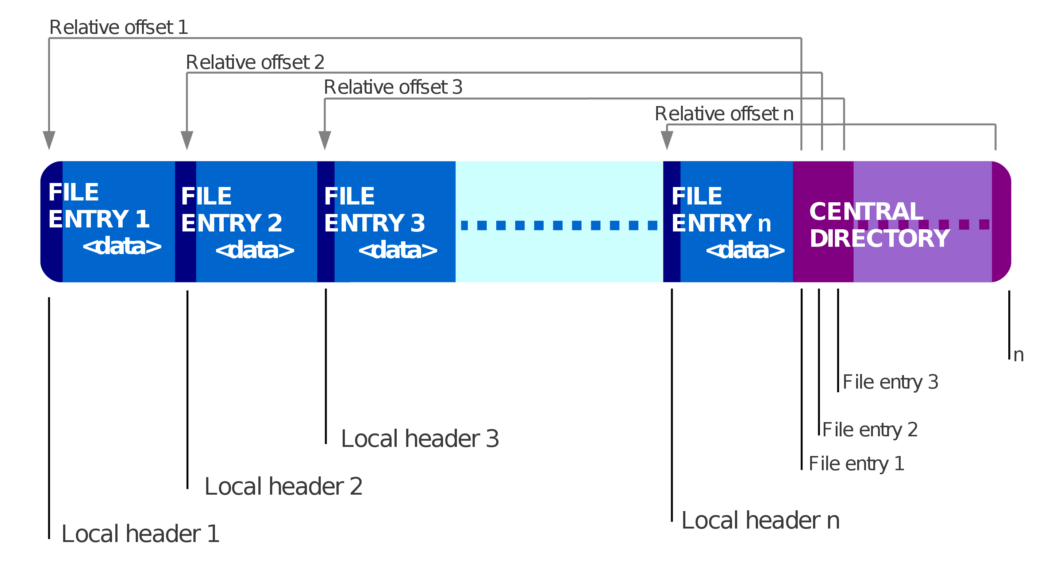
Structure of a ZIP file
Source: https://en.wikipedia.org/wiki/ZIP_(file_format)

Slide 7
JavaScript & ZIP Format
Native support in browsers, Node.js, Deno, Bun, etc.:
  ZIP: no
  DEFLATE: yes (via gzip/zlib)
Rich ecosystem of third-party libraries:
  zip.js
  fflate
  client-zip
  yazl/yauzl
  JSZip
  ...

Slide 8
Example with zip.js
Writing a ZIP file
import { ZipWriter, Uint8ArrayWriter } from "@zip-js/zip-js"
const zipDataWriter = new Uint8ArrayWriter()
const zipWriter = new ZipWriter(zipDataWriter)
for await (const { name } of readDirectory(inputFolder)) {
const readableStream = await readFileStream(name)
await zipWriter.add(name, readableStream)
}
await zipWriter.close()
const zipData = zipDataWriter.getData() // Uint8Array
console.log("zip file data:", zipData)

Slide 9
Example with zip.js
Reading a ZIP file
import { ZipReader, BlobReader, BlobWriter } from "@zip-js/zip-js"
const zipReader = new ZipReader(new BlobReader(blob))
const entries = await zipReader.getEntries()
for (const entry of entries) {
const blob = await entry.getData(new BlobWriter())
console.log("file:", entry.filename, "blob:", blob)
}
await zipReader.close()

Slide 10
Integration in the web project
2 - Writing and reading the zip file in JavaScript
Addition of /scripts:
  create-zip.js and read-zip.js: test files
  lib/utils-fs.js:
    readDirectory(folder): returns the filenames in a directory as a string array
    readBinaryFile(filename): returns a file as a Uint8Array
    createFile(filename): creates a file and returns the write stream
  lib/utils.js:
    encodeText(text): encodes UTF-8 text as a Uint8Array
  lib/utils-zip.js:
    getZipData(inputFolder): returns the Uint8Array content of a ZIP storing files read from a folder

Slide 11
ZIP format (cont.)
Extensible format:
  Add 64KB of data after the ZIP file (comment)
  Offset greater than zero for the first entry in the zip file
Self-extracting HTML page structure:
  ■ HTML content up to an opening tag <!--
  ■ ZIP file content
  ■ closing tag --> and end of HTML content
HTML content includes:
  Script of zip.js library (zip.min.js)
  Script to extract and display the content of the zip file

Slide 12
Self-extracting HTML page template
<!DOCTYPE html>
<html>
<head>
<meta charset=utf-8>
<title>Please wait...</title>
<script>${ZIP_JS_SCRIPT}</script>
</head>
<body>
<p>Please wait...</p>
<!-- ZIP data -->
<script type=module>${MAIN_SCRIPT}</script>
</body>
</html>

Slide 13
Self-extracting HTML/ZIP file (1/2)
3️ - Reading the ZIP file from the HTML page
Addition of /assets:
  zip.min.js: ZIP file reading
  page-extraction.js: extraction and display of the page
Additions to /scripts:
  lib/html-template.js: HTML template for self-extracting page
  index.js: generation of self-extracting HTML/ZIP file

Slide 14
Self-extracting HTML/ZIP file (2/2)
Changes in /scripts:
  Addition in lib/utils.js:
    minifyScript(script): returns the minified script
  Addition in lib/utils-fs.js:
    readTextFile(filename): returns the contents of a file as text

Slide 15
Self-extracting HTML/ZIP file
4 - Extracting and displaying the page /index.html from the
  ZIP file
Addition in /assets/page-extraction.js:
  getExtension(filename): returns the extension of a file name
  (e.g. ".txt")
Changes in /assets/page-extraction.js:
  extractResources: add support for text files
  displayPage: HTML page display implementation

Slide 16
Self-extracting HTML/ZIP file
5️ - Displaying the full HTML page
Addition in /assets/page-extraction.js:
  resolveDependencies(resources): replaces external resource paths with resources extracted from the ZIP
6 - Handling scripts in the page
Change in /assets/page-extraction.js:
  displayPage: replace scripts in the DOM with their clones
⚠️ Reading the page from the filesystem

Slide 17
Reading the ZIP file from the DOM (1/2)
7 - Displaying ZIP data in hexadecimal format and read in text form
via Node#textContent
Temporary removals in /assets/page-extraction.js:
  extractResources
  resolveDependencies
  getZipData
Temporary change in /assets/page-extraction.js:
  Replacement of displayPage(resources) with displayData()
Addition of temporary styles to display text in monospace fonts in /scripts/lib/html-template.js

Slide 18
Reading the ZIP file from the DOM (2/2)
8 - Comparing the impact of UTF-8 and windows-1252
encoding
Change to the charset attribute of the <meta> tag

Slide 19
Reading the ZIP file from the DOM
9 - Testing data corruption caused by encodings and determine the
  best encoding
Data corruption:
  Character encoding on 1 byte (e.g. windows-1252) vs several bytes (e.g. UTF-8)
  Replacement by a line feed \n of all:
    carriage return \r
    carriage return followed immediately by a line feed \r\n
  Characters with a code greater than 127, i.e. beyond the 7-bit ASCII table

Slide 20
Reading the ZIP file from the DOM (1/2)
10 - Bypassing the call to await fetch("")
Changes in /scripts/lib/html-template.js:
  Replacement of utf-8 encoding with windows-1252
  Addition of ■ --><script type=text/json> text
  Addition of ■ ZIP extra data (encoded in JSON)
  Replacement of ■ --> with </script> in the end of the HTML content

Slide 21
Self-extracting HTML page template
<!DOCTYPE html>
<html>
<head>
<meta charset=windows-1252>
<title>Please wait...</title>
<script>${ZIP_JS_SCRIPT}</script>
</head>
<body>
<p>Please wait...</p>
<!-- ZIP data -->
<script type=text/json> ZIP extra data </script>
<script type=module>${MAIN_SCRIPT}</script>
</body>
</html>

Slide 22
Reading the ZIP file from the DOM (2/2)
Addition in /scripts/lib/utils-zip.js:
  getExtraData(zipData): generation of ZIP extra data
Change in /scripts/index.js:
  writeFile: addition of ZIP extra data
Change in /assets/page-extraction.js:
  getZipData: read content via the DOM comment (ZIP data) and the JSON script (ZIP extra data)

Slide 23
Reading the ZIP file from the DOM
11 - Fixing MIME type issues in external resources
Changes in /assets/page-extraction.js:
  resolveDependencies: support for MIME resource types (text or binary)
  extractResources: change of the code testing the filename extension of a resource
⚠️ The page remains encoded in windows-1252

Slide 24
PNG format
Created in 1996
Standard, royalty-free image format
Lossless compression (DEFLATE)
File composed of a sequence of chunks
Chunk structure:
  Chunk data size (4 bytes)
  Chunk type (4 bytes) : IHDR, IDAT, IEND, tEXt ...
  Chunk data (variable size)
  Cyclic redundant code (CRC32) computed from all block data

Slide 25
PNG format
Minimal structure of a PNG file:
  PNG signature (8 bytes) - mandatory
    89 50 4E 47 0D 0A 1A 0A
  IHDR chunk for the header (13 bytes) - mandatory
    00 00 00 0D 49 48 44 52 ...
  IDAT chunk(s) for the image data
  IEND chunk for the trailer (12 bytes)
    00 00 00 00 49 45 4E 44 AE 42 60 82
Optional chunk(s):
  tEXt chunks for storing random text or binary data
    xx xx xx xx 74 45 58 74 ...

Slide 26
PNG format
Data type |  | Data in hexadecimal | Mandatory | Size (bytes)
PNG signature |  | 89 50 4E 47 0D 0A 1A 0A | ✓ | 8
Header | IHDR | 00 00 00 0D 49 48 44 52 ... | ✓ | 13
...
Data | IDAT | xx xx xx xx 49 44 41 54 ... |  | 12 + n
...
Trailer | IEND | 00 00 00 00 49 45 4E 44 AE 42 60 82 | ✓ | 12

Slide 27
Polyglot PNG format (1/3)
12 - Encapsulating the HTML/ZIP file in a PNG file
Polyglot PNG file structure:
      PNG signature
  IHDR - Header chunk
  tEXt - Text chunk ■
    HTML content up to the opening tag <!--
  IDAT - Data chunk(s) ■
  tEXt - Text chunk ■
    closing tag --> and end of the HTML content
  IEND - Trailer chunk

Slide 28
Polyglot PNG format (2/3)
Data type |  | Data in hexadecimal | Mandatory | Size (bytes)
PNG signature |  | 89 50 4E 47 0D 0A 1A 0A | ✓ | 8
Header | IHDR | 00 00 00 0D 49 48 44 52 ... | ✓ | 13
Text | tEXt | xx xx xx xx 74 45 58 74 ... |  | 12 + n
...
Data | IDAT | xx xx xx xx 49 44 41 54 ... |  | 12 + n
...
Text | tEXt | xx xx xx xx 74 45 58 74 ... |  | 12 + n
Trailer | IEND | 00 00 00 00 49 45 4E 44 AE 42 60 82 | ✓ | 12

Slide 29
Template of the polyglot HTML page
<!DOCTYPE html>
<html>
<head>
<meta charset=windows-1252>
<title>Please wait...</title>
<script>${ZIP_JS_SCRIPT}</script>
</head>
<body>
<p>Please wait...</p>
<!-- PNG data -->
<!-- ZIP data -->
<script type=text/json> ZIP extra data </script>
<script type=module>${MAIN_SCRIPT}</script>
</body>
</html>

Slide 30
Polyglot PNG format (3/3)
Change in /assets/html-template.js:
  Addition of the HTML comment to store image data (IDAT chunks)
Addition of utils-png.js in /scripts/lib:
  createTextChunk(keyword, payloadData): returns a new tEXt chunk
  getHeaderData(imageData): returns the PNG signature + IHDR chunk
  getDataChunks(imageData): returns IDAT chunk(s)
  getTrailerChunk(imageData): returns IEND chunk
  getChunkDataOffset(): returns data offset in a tEXt chunk
Addition in /scripts/lib/utils.js:
  mergeData(...data): merges multiple instances of Uint8Array
Change in /scripts/index.js:
  writeFile: integrate PNG format

Slide 31
Polyglot PNG format
Improvements in /assets/page-extraction.js:
1️3 - Removing text nodes induced by PNG format
  Addition of cleanupPNGData()
1️4 - Fixing HTML page rendering mode and improve support of scripts
  Use document.open(), document.write() and document.close() in displayPage()
1️5 - Reusing the (polyglot) image in the HTML page
  Deletion of the image in DEPENDENCIES
  Move of image image.png in /assets
  Replacement of image.png with # in /project/index.html

Slide 32
Conclusion
Limitations of the final implementation:
  Manual dependency resolution
  Exceeding the 64KB data limit after ZIP
  Presence of --> in ZIP or PNG binary data
  Using String#replaceAll() to replace paths in text files instead of relying on parsing
  No <meta> tag containing the CSP
  No support for frames...
Alternative formats: MHTML, Web Bundle, WARC/WACZ, MAFF ...
Is it dangerous? 🤷
  GIFAR

